Slide 1
Abacus
Lesson 2

Slide 2
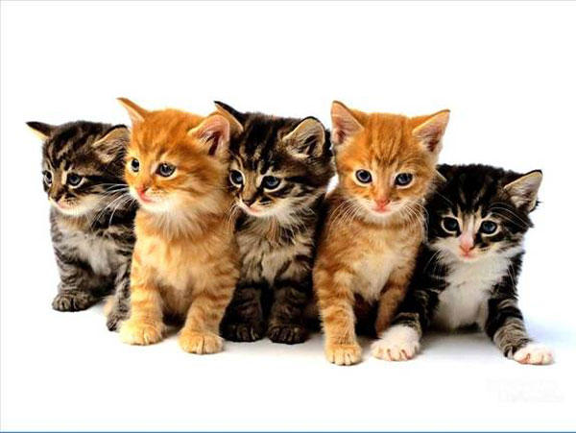
Big Friends & Little Friends
Breakdowns of 10 are called Big Friends
Breakdowns of 5 are called Little Friends

Slide 3
Big friends
1 → 9
2 → 8
3 → 7
4 → 6
5 → 5
6 → 4
7 → 3
8 → 2
9 → 1
Big Friends Chant
Big Friends Rap

Slide 4
Add & subtract using big friends
Addition
Subtraction
+9= -1+10
+8= -2+10
+7= -3+10
+6= -4+10
+5= -5+10
+4= -6+10
+3= -7+10
+2= -8+10
+1= -9+10
-9= +1-10
-8= +2-10
-7= +3-10
-6= +4-10
-5= +5-10
-4= +6-10
-3= +7-10
-2= +8-10
-1= +9-10

Slide 5
Little Friends
Little Friends Chant
1 → 4
2 → 3
3 → 2
4 → 1
Little Friends Rap

Slide 6
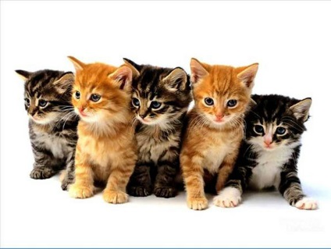
Add & subtract using little friends
Subtraction
Addition
+4= -1+5
+3= -2+5
+2= -3+5
+1= -4+5
-4= +1-5
-3= +2-5
-2= +3-5
-1= +4-5

Slide 7
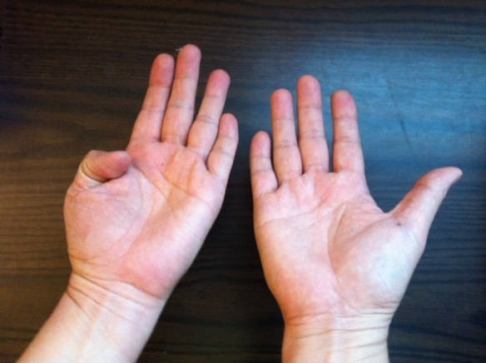
Teach them as a rap
You may make up a song, but that means teacher and students all need to be able to sing.
You may teach it as a rap, and add movements.
Then you also teach a mnemonic, in case they forget it:
Use both hands, fold the number of fingers to add. The remaining fingers are the number to subtract.
Big Friend of 1 is 9

Slide 8
Thank you!
Practice, practice, practice!

