Slide 1
Mental Abacus
Lesson 3: Teaching Sequence

Slide 2
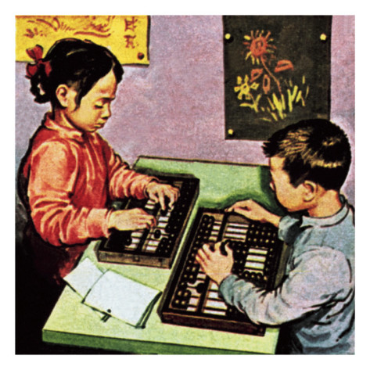
Introduction
Explain origin and benefits of abacus
Explain benefits of 2-hand method

Slide 3
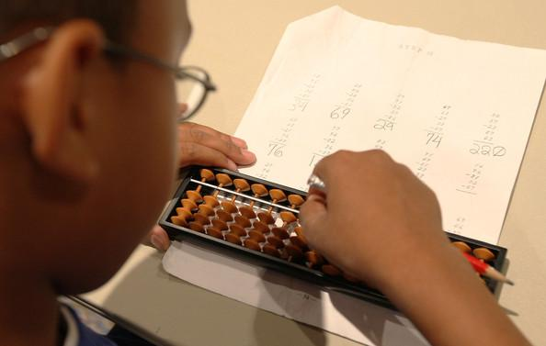
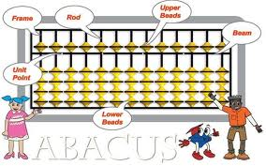
Basics
Names of parts of the abacus
How to hold pencil
Which fingers push beads

Slide 4
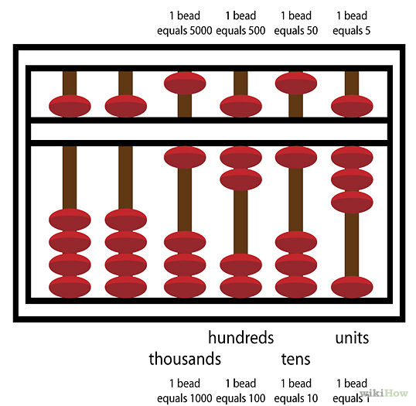
Reading Numbers
Single rod
Multiple rods
Go up to million
Younger children need more practice

Slide 5
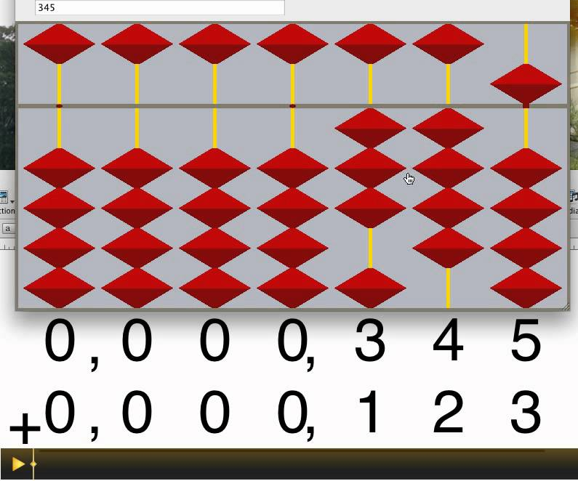
Learn how to add and subtract
Use basic workbook
Goal: to use correct fingers
Push correct number of beads
Younger children may confuse “number” of beads with “name” of bead
Keep practicing till there is no hesitation

Slide 6
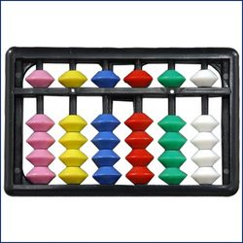
Add & Subtract on 1 Rod
Within 4
Add 5, 6, 7, 8, 9
Go up to 10 numbers,
Mix addition and subtraction

Slide 7
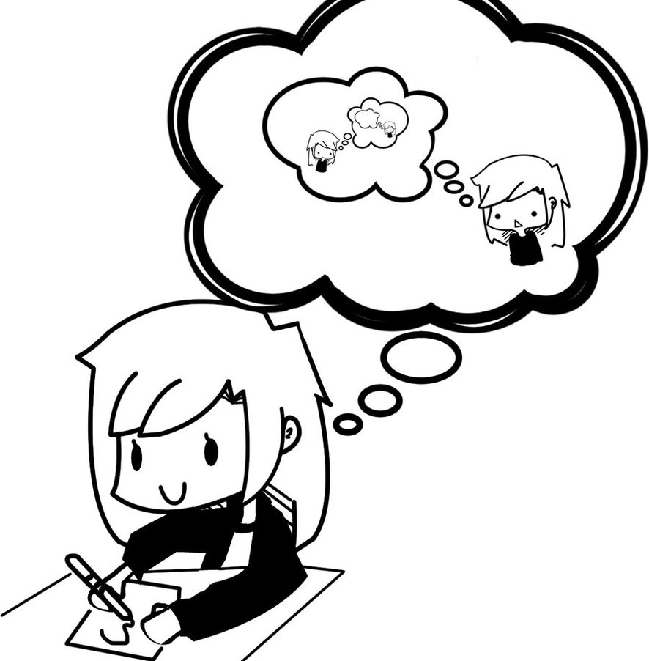
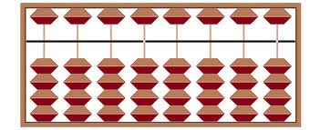
Start visualization exercises
Use picture of abacus
Add and subtract on one rod

Slide 8
Practice other mental skills
Memory exercises
What did you eat for breakfast?
The weather yesterday
Other
Relaxation exercises
Straight back, flat feet, hands on knees, eyes closed
Slow breathing, slower, slower
No cringing or frowning
Visualize blue sky,

Slide 9
Learn Big Friends
Put poster on wall
Teach as a chant
Use fingers and clapping
Practice daily as a class

Slide 10
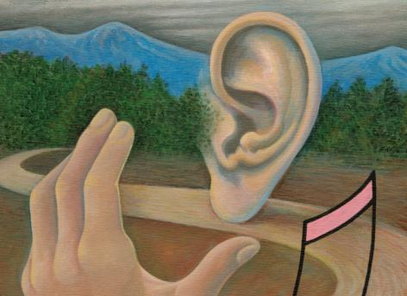
Add & Subtract using Big Friends
While doing worksheet, student should say out loud the chant:
Example:
8
+9
-1+10
answer: 17
If this is done regularly, the fingers will automatically do -1+10 when the mouth says (and the brain thinks) +9
Whole class does a few lines in unison out loud.
Then each can work on his/her own.

Slide 11
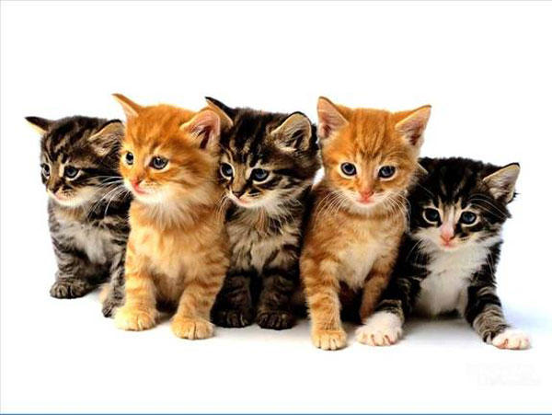
Learn Little Friends
Put poster on wall
Teach as a rap
Use fingers and clapping
Practice daily as a class

Slide 12
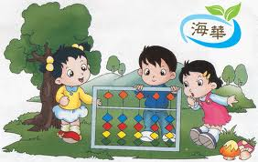
Add & Subtract Using Little Friends
While doing worksheet, student should say out loud the chant:
Example:
3
+4
-1+5
answer: 7
Let fingers memorize movements
Whole class does a few lines in
unison out loud.
Then each can work on his/her own.

Slide 13
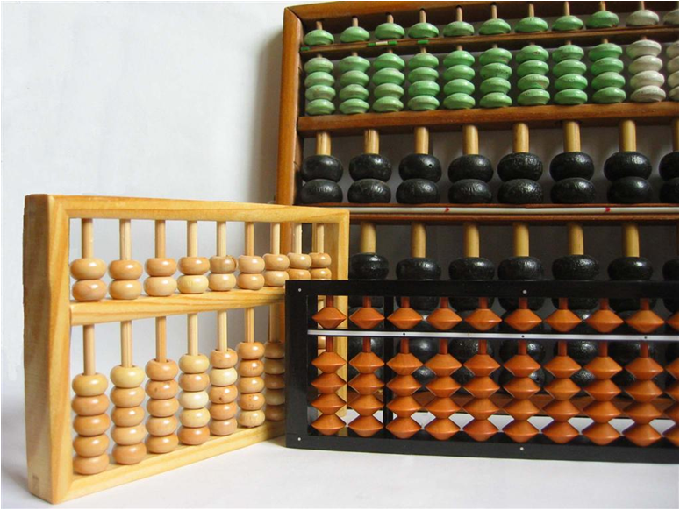
Practice +/- on 2 or more rods
When all big friends and little friends have been taught, there follows a section of mixed practice.
Follow this sequence:
A) try pushing normal amount of beads
B) if not possible, look for little friends
C) if not possible, then look for big friends

Slide 14
Start Daily Practices
Say out loud:
1
+1, is 2
+1, is 3
+1, is 4
+1, is 5 (little friends)
+1, is 6
+1, is 7
+1, is 8
+1, is 9
+1 is 10 (big friends)
etc
+1 till 20
+2 till 20
+3 till 30
+4 till 40
+5 till 50
+6 till 60
+7 till 70
+8 till 80
+9 till 90

Slide 15
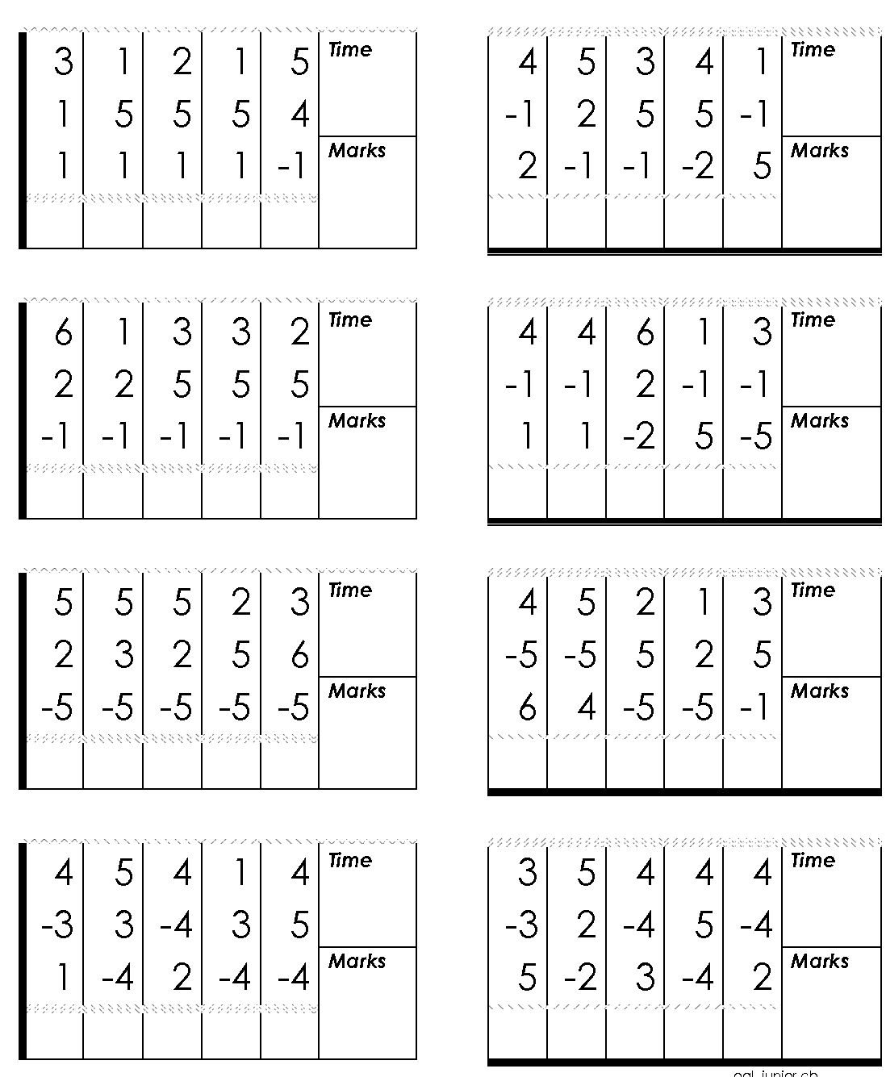
Start on Level 12
There are 12 levels of abacus skills
Level 12 is the lowest
Single digit, addition/subtraction, 3 numbers

Slide 16
Mental practice
Daily, do not forget to practice mentally
If time does not allow, at least once a week

Slide 17
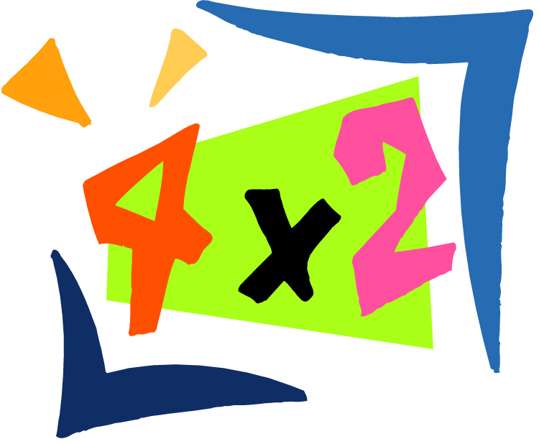
Looking to next levels
Master Times Tables
Multiplication
Division

Slide 18
Thank You!
From TER

